Slide 1
Markov Chain Monte Carlo
Casey Sobecks

Slide 2
Contents
Following “Group action Markov chain Monte Carlo for accelerated sampling of energy landscapes with discrete symmetries and energy barriers” by Matthew Grasinger (Apr 2022)
arXiv:2205.00028 [cond-mat.stat-mech]
Monte Carlo background
Example
Simple Harmonic Oscillator (SHO)
Double Well
Conclusion

Slide 3
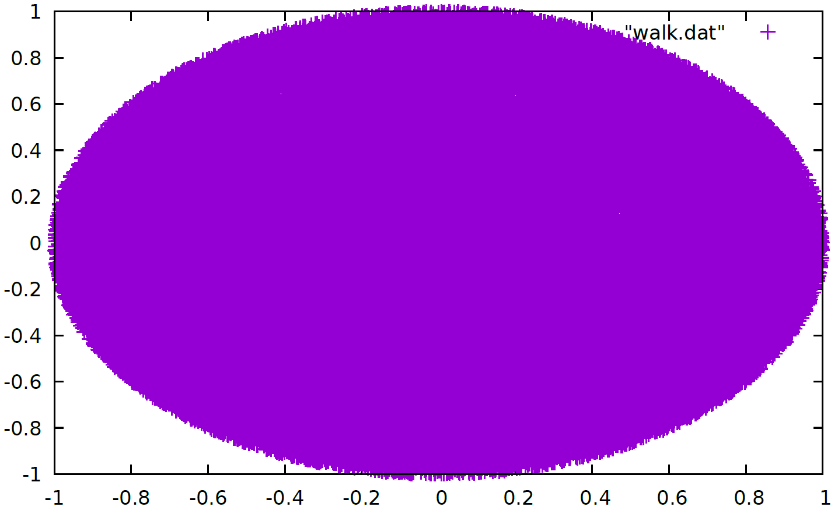
Monte Carlo Differences
Regular Monte Carlo (MC)
Markov Chain Monte Carlo (MCMC)
Uniform Random Sampling
Good for finding area of a circle
Next data point depends on previous data point
Correlated data
Works better on complicated objects or functions
difficult to sample directly
Some burn in time necessary

Slide 4
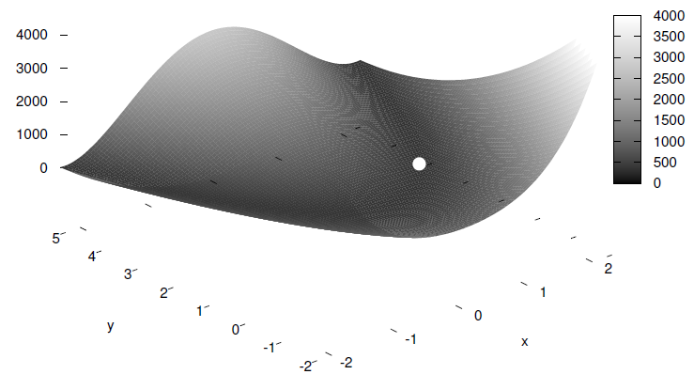
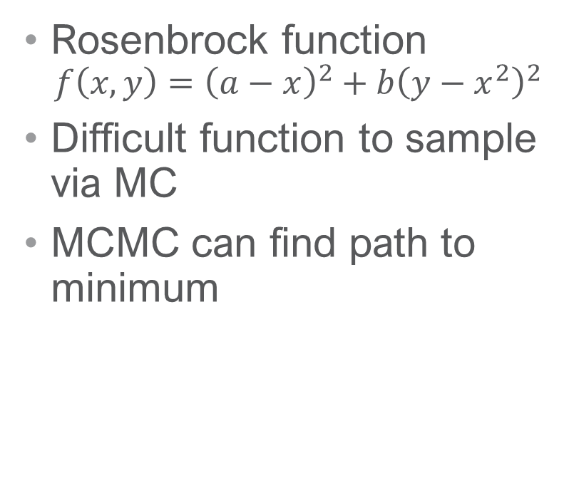
Markov Chain Example
Rosenbrock function
$$f\left(x,y\right)={\left(a−x\right)}^{2}+b{\left(y−x^{2}\right)}^{2}$$
Difficult function to sample via MC
MCMC can find path to minimum

Slide 5
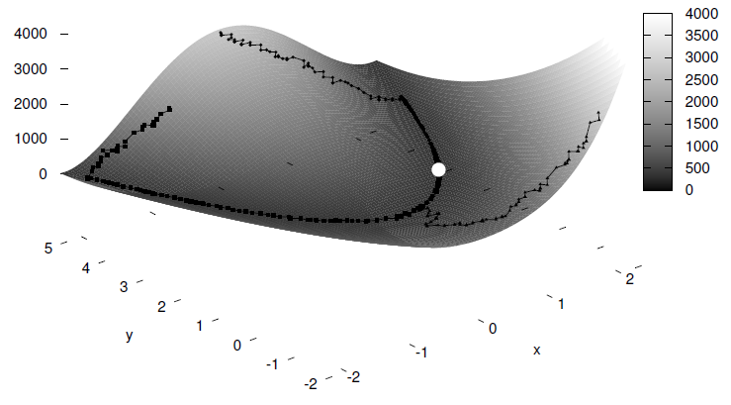
Markov Chain Example
Rosenbrock function
$$f\left(x,y\right)={\left(a−x\right)}^{2}+b{\left(y−x^{2}\right)}^{2}$$
Difficult function to sample via MC
MCMC can find path to minimum

Slide 6
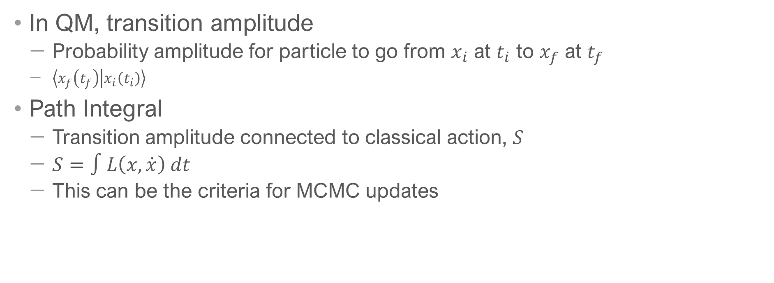
MCMC and Feynman Path Integrals
In QM, transition amplitude
Probability amplitude for particle to go from $x_{i}$ at $t_{i}$ to $x_{f}$ at $t_{f}$
$\left\langle x_{f}\left(t_{f}\right) | x_{i}\left(t_{i}\right)\right\rangle$
Path Integral
Transition amplitude connected to classical action, $S$
$S=∫L\left(x,\dot{x}\right) dt$
This can be the criteria for MCMC updates

Slide 7
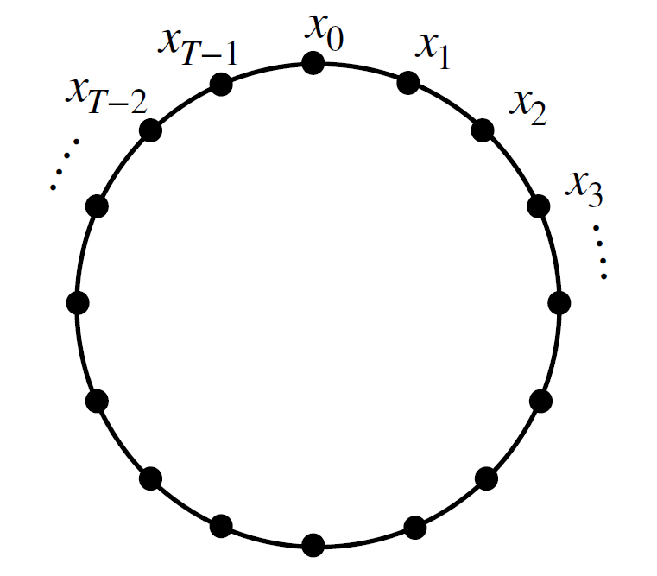
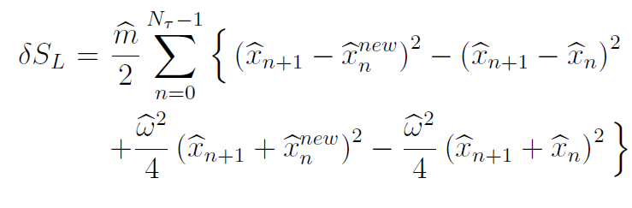
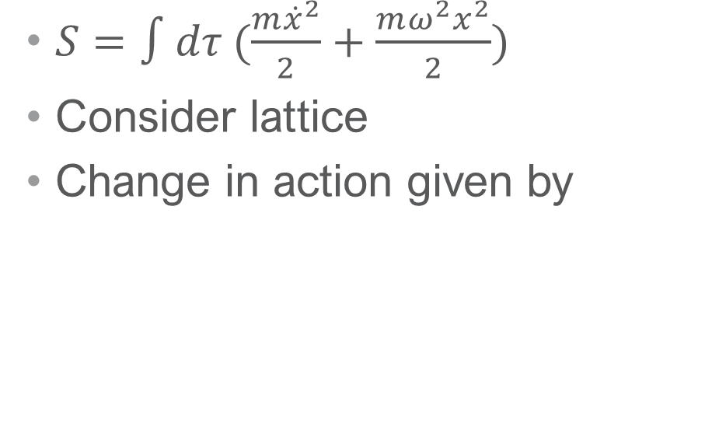
MCMC SHO
$S=∫dτ (\frac{m{\dot{x}}^{2}}{2}+\frac{mω^{2}x^{2}}{2})$
Consider lattice
Change in action given by

Slide 8
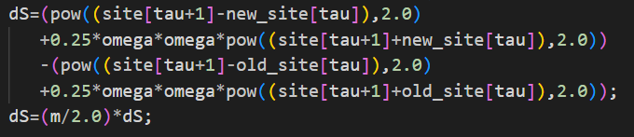
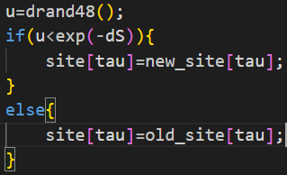
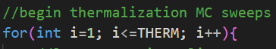
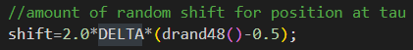
SHO Implementation
Change in action
Metropolis Update Burn in Time:

Slide 9
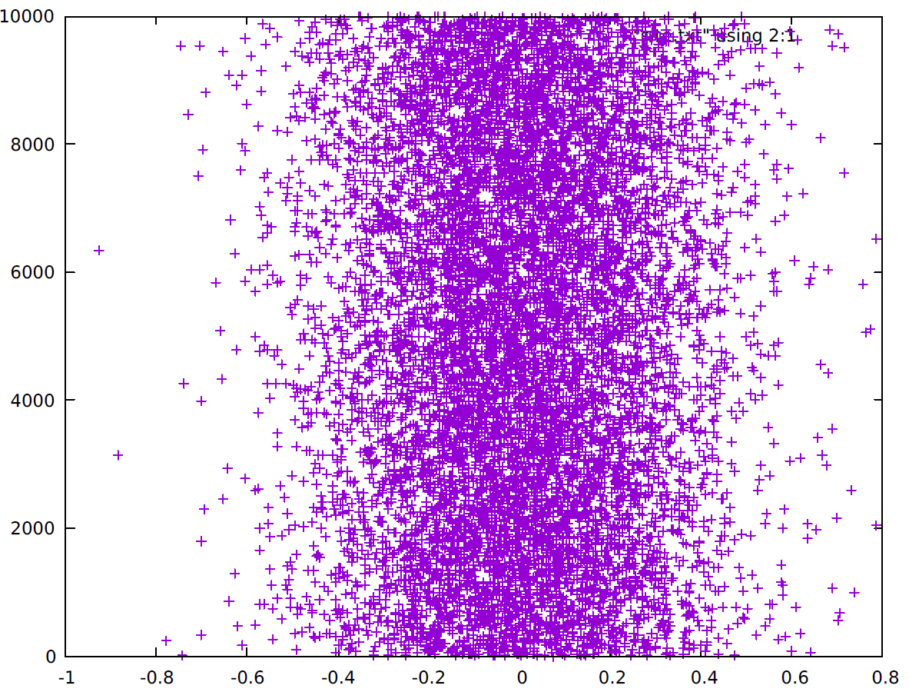
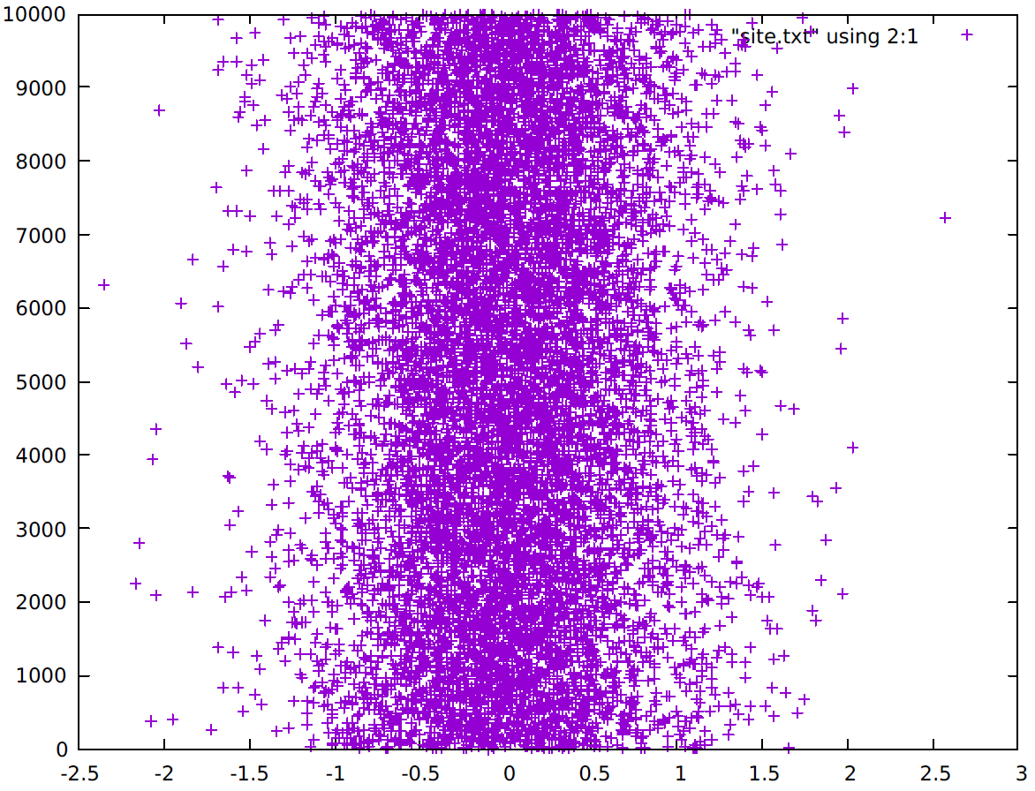
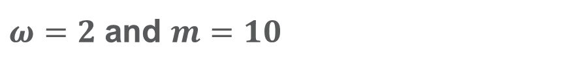
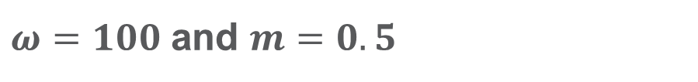
SHO Results
$ω=2$ and $m=10$
$ω=100$ and $m=0.5$

Slide 10
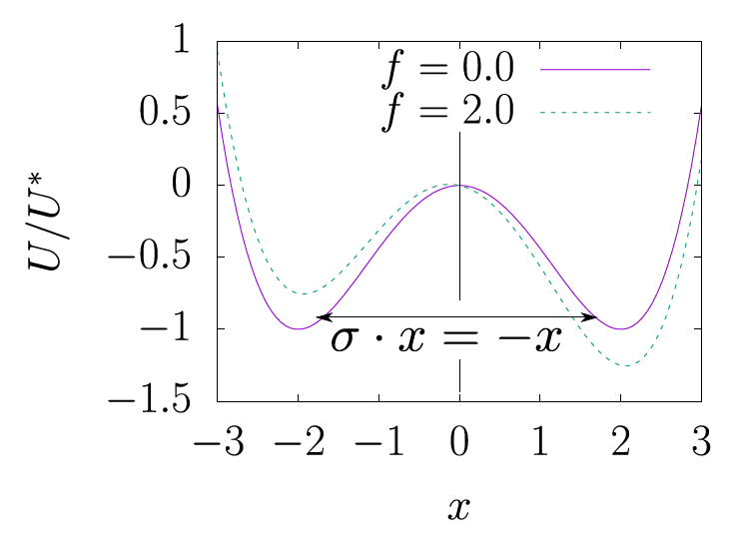
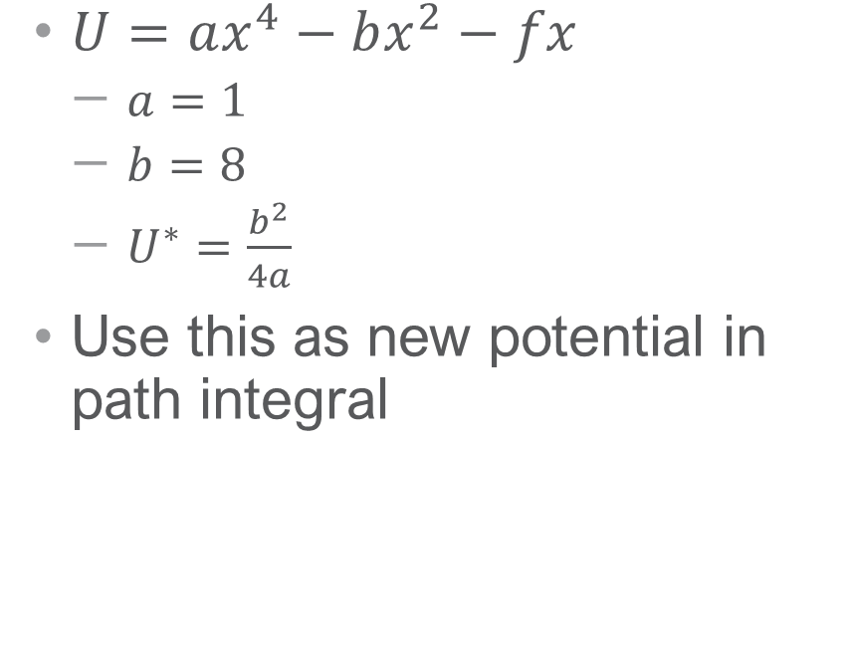
Double Well
$U=ax^{4}−bx^{2}−fx$
$a=1$
$b=8$
$U^{∗}=\frac{b^{2}}{4a}$
Use this as new potential in path integral

Slide 11
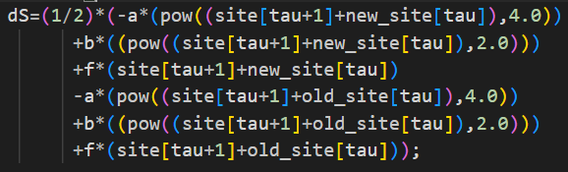
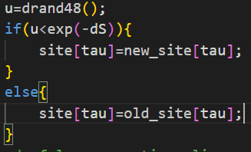
Double Well Implementation
Change in action: Burn in time:
Metropolis Update:

Slide 12
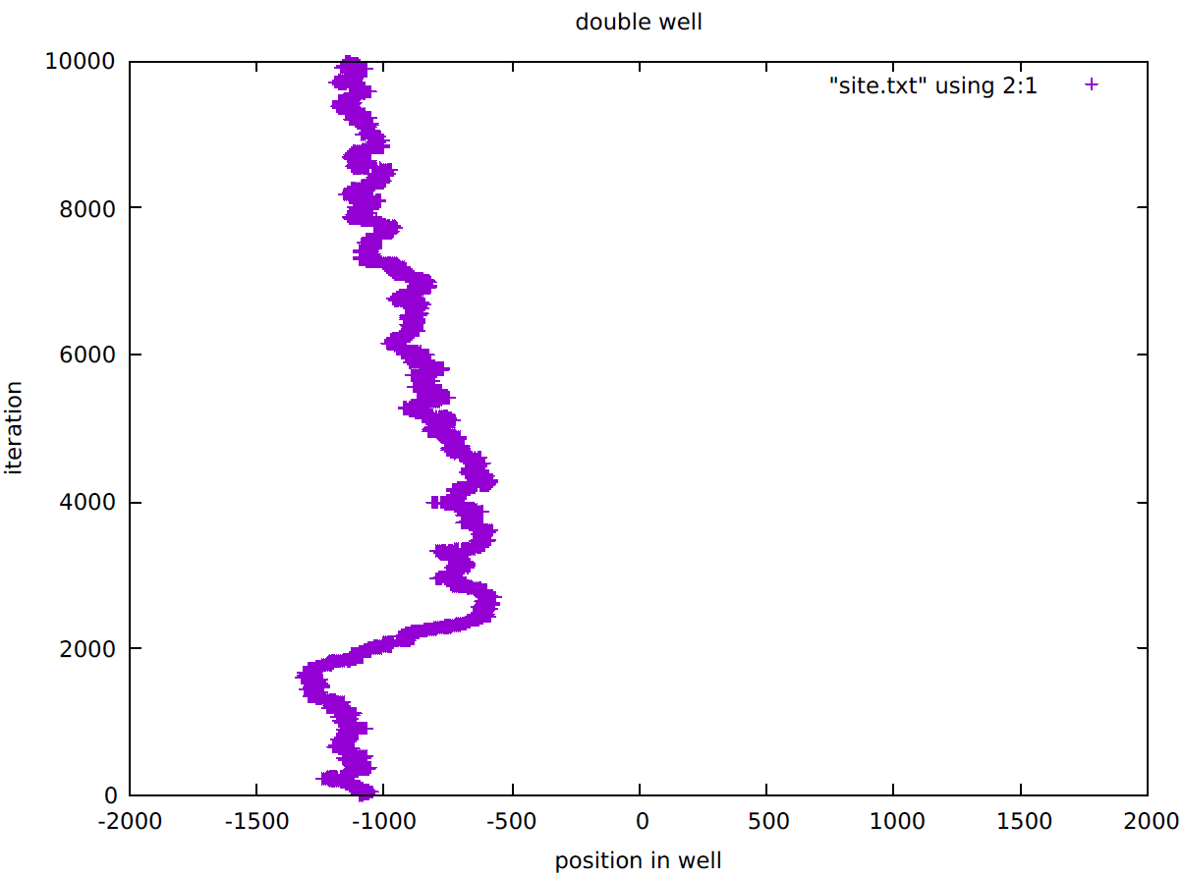
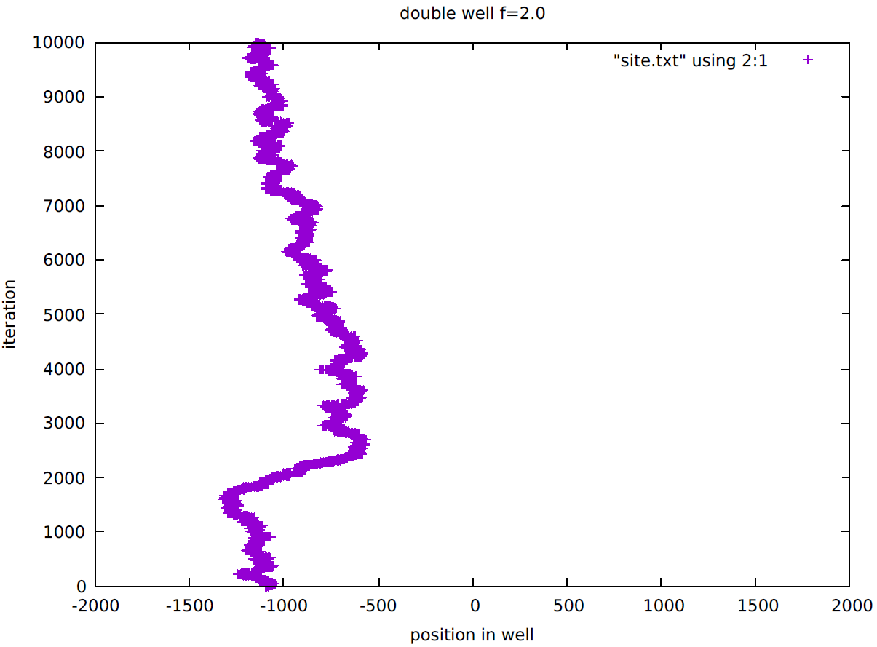


Double Well Results
Symmetric Well, $f=0$
Asymmetric Well, $f=2$

Slide 13
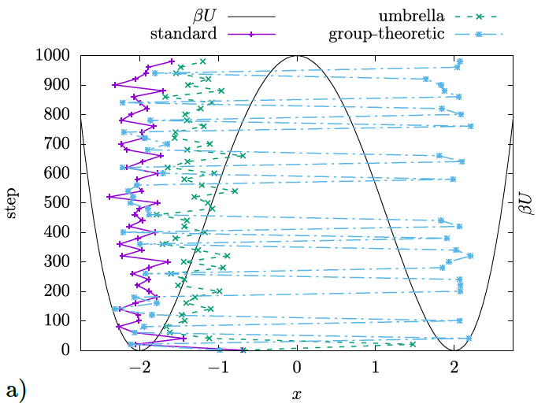
Paper Results
Comparing results
MCMC is not perfect
Different ways to optimize

Slide 14
Conclusion
MCMC can describe difficult functions
More efficient than regular MC
Not perfect, so lots of room for research
Current research tool at UTK
At least in Condensed Matter

Slide 15
Thank you

